Slide 1
IBM Coursera Advanced Data Science Capstone Project
Đỗ Quang Anh

Slide 2
Outlines
Dataset – Use case
Data Exploration
Data cleansing – DATA AGGREGATION
Model definition and training
Model evaluation – hyperparameters tuning

Slide 3
Dataset
Dataset published by Audioscrobbler – a music recommendation system for last.fm
userID | artistID | playCount
113186 | 46843 | 56
745456 | 84646 | 118
… | … | …
… | … | …
misspelledID | standardID
84646 | 184528
148328 | 435846
… | …
Contains:
140,000 unique users
1.6 million unique artists
artistID | artist_name
84646 | Ed Sheeran
148328 | Coldplay
… | …
Source: http://www.iro.umontreal.ca/~lisa/datasets/profiledata_06-May-2005.tar.gz

Slide 4
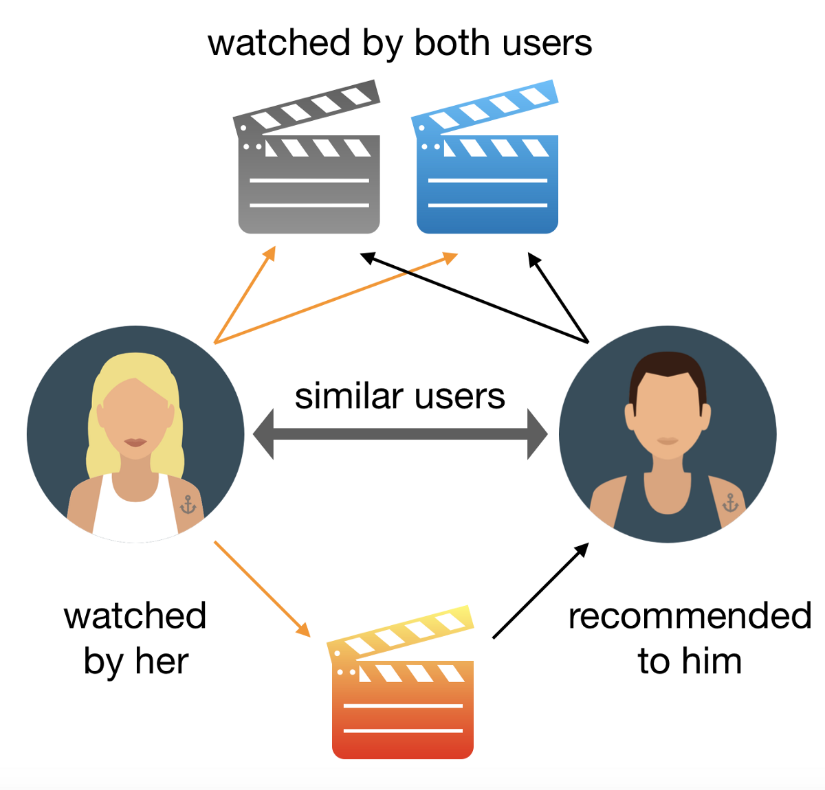
Use case
Develop music recommendation system

Slide 5


Data exploration

Slide 6
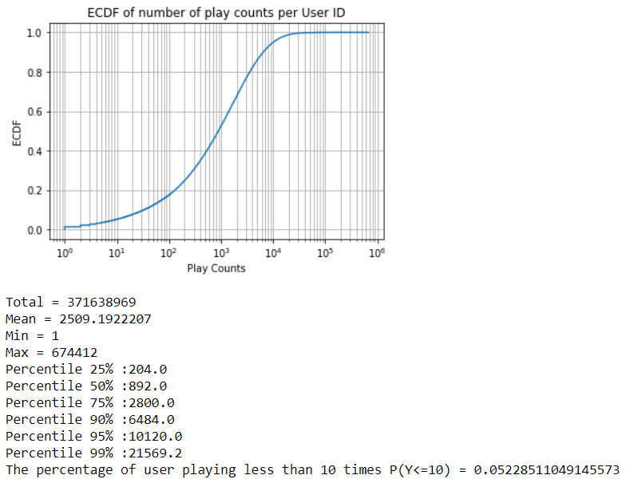
Data exploration
A user played 2509 times on average
50% of the users have the play counts less than or equal to (<=) 892times.
75% of the users have the play counts less than or equal to (<=) 2800 times.
95% of the users have the play counts less than or equal to (<=) 10120 times.
About 7746 users (5.23%) have the play counts less than or equal to (<=) 10 times. These users have very little interaction with the system, so there is more difficult for recommending for these users

Slide 7
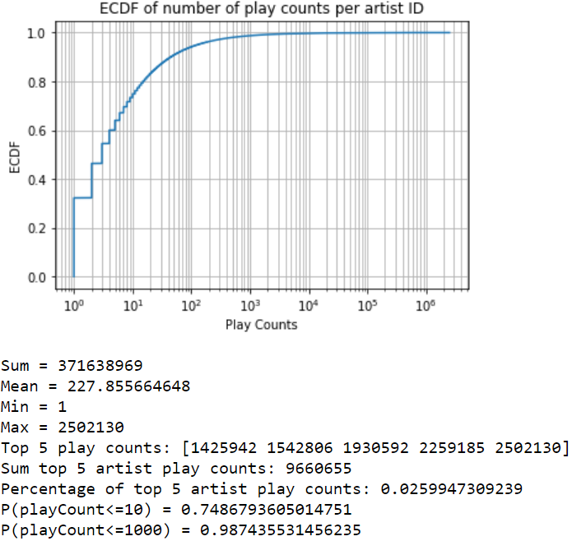
Data exploration
In average, playCount per artist is 227 times
Only 74.87% of the artists is played less than or equal to (<=) 10 times.
And 98.74% of the artists is played less than or equal to (<=) 1000 times.
Top 5 artist play counts: [1425942 1542806 1930592 2259185 2502130].
This accounts for 2.6% on overall number of playCount (5 out of 1631028 artists). Moreover, the play count of top 5 artist is much higher than the mean. So we can infer that we can recommend most-played artists to every user with this top 5 artirst, and still get high performance.

Slide 8
Data exploration
In average, playCount per artist is 227 times
Only 74.87% of the artists is played less than or equal to (<=) 10 times.
And 98.74% of the artists is played less than or equal to (<=) 1000 times.
Top 5 artist play counts: [1425942 1542806 1930592 2259185 2502130].
This accounts for 2.6% on overall number of playCount (5 out of 1631028 artists). Moreover, the play count of top 5 artist is much higher than the mean. So we can infer that we can recommend most-played artists to every user with this top 5 artirst, and still get high performance.

Slide 9
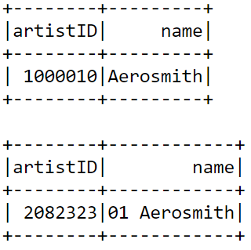
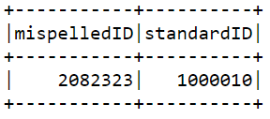
Data Cleansing
Same artist but different IDs =>
Solved: Replace misspelledID by StandardID

Slide 10
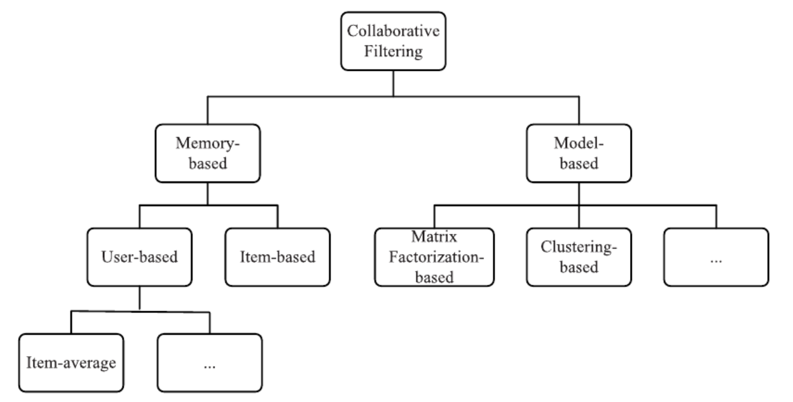
Model definition
Collaborative Filtering

Slide 11
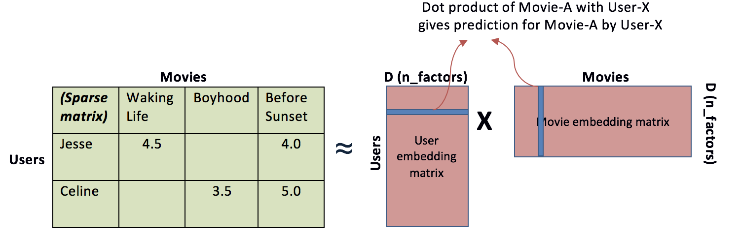
Model definition
Matrix Factorization

Slide 12
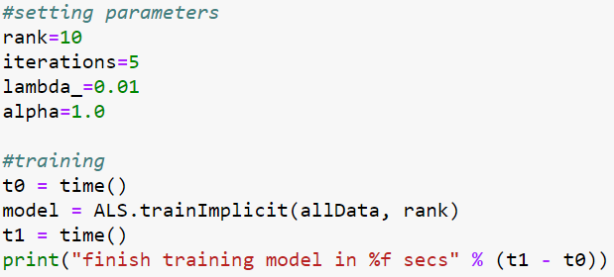
Model Training
A model can be trained by using ALS.trainImplicit(<training data>, <rank>)
Split data to 70% for training and 30% for testing
We can also use some additional parameters to adjust the quality of the model. Currently, let's set:
Param | Value
Rank | 10
Iterations | 5
Lambda | 0.01
Alpha | 1.0

Slide 13
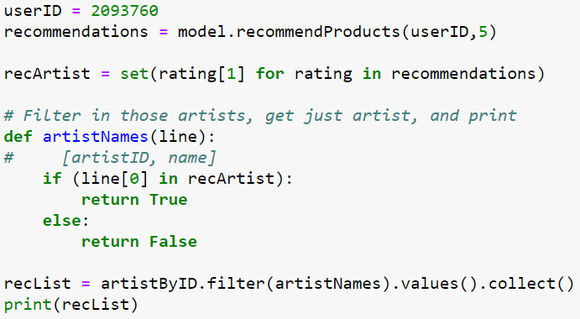
Model Training
Let’s predict the top 5 artists which user has ID = 2093760 may find interesting
=>

Slide 14
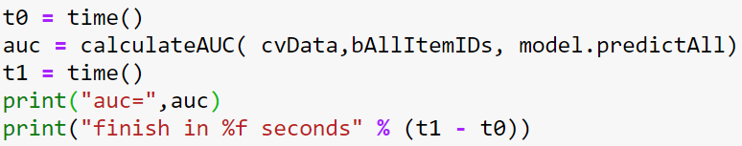

Model Evaluation

Slide 15
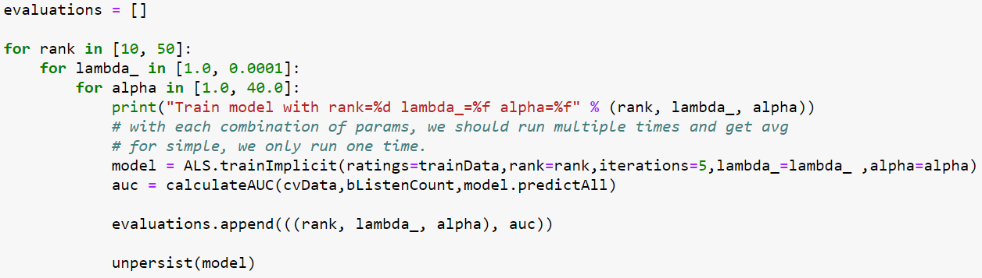
Hyperparameter tuning

Slide 16
Hyperparameter tuning
Grid Search
Rank | Lambda | Alpha | AUC
10 | 1.0 | 40.0 | 0.9738
10 | 0.0001 | 40.0 | 0.9718
50 | 1.0 | 40.0 | 0.9715
50 | 0.0001 | 40.0 | 0.97
10 | 1.0 | 1.0 | 0.9644
50 | 1.0 | 1.0 | 0.9592
10 | 0.0001 | 1.0 | 0.9584
50 | 0.0001 | 1.0 | 0.9427
The model with the largest AUC score has the combination of Rank = 10. Lambda = 1.0 and Alpha = 40.0

Slide 17
Conclusion
The model is highly biased on the artists who have large number of play counts
We may not need to include lambda and alpha parameters to the model if we only retrieve the top result less than10 artists.

Slide 18
Links
Gist: https://github.com/doquanganh/Cousera-Advanced-Data-Science-with-IBM-anhdq/blob/9d1b969a354dd2deb5e75b32898282e63af95715/IBM%20Coursera%20Advanced%20Data%20Science%20Capstone.ipynb

